Slide 1
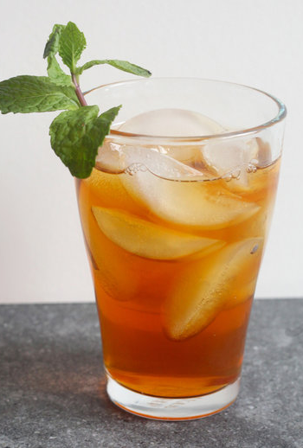
Refreshing Herbal Tea
Lora Kasselman, PhD, MPH, Herbal Medicine student

Slide 2
Welcome!
Introductions

Slide 3
Welcome!
Today we will:
Discuss 4 different herbs
Explore what properties they have
Detail how they can help cool you down on a hot day
Describe how they can be made into tea
Brew one herbal tea
Create our own herbal tea (infusion) blends

Slide 4
Herbs

Slide 5
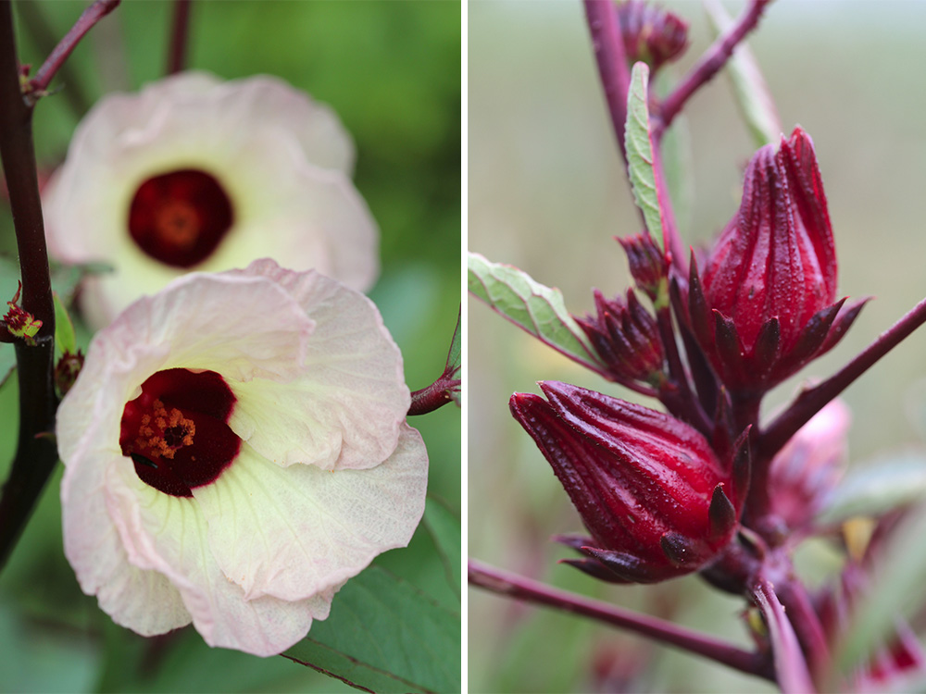
Herb #1: Hibiscus (Hibiscus sabdariffa)
Background
Native to N. Africa and S.E. Asia
Tea made from part of flower
Deep red color
Egypt and Sudan – karkade – “refrigerant” tea
Notes:
https://chestnutschool.wpenginepowered.com/wp-content/uploads/2012/11/Roselle-Hibiscus-left-and-right.jpg
https://www.herbalgram.org/resources/herbalgram/issues/74/table-of-contents/article3102/
Refrigerants work by lowering your body’s temperature and cooling its tissues
Cold hardy hibiscuses are different species
Hibiscus sabdariffa is in the mallow (malvaceae) family

Slide 6
Herb #1: Hibiscus (Hibiscus sabdariffa)
Properties
Sweet, astringent, sour, cooling
Anti-inflammatory, antioxidant, antimicrobial, cardiotonic, cholesterol-lowering, diuretic, hypotensive, astringent, demulcent
Notes:
https://chestnutherbs.com/medicinal-benefits-of-hibiscus/
Refrigerants work by lowering your body’s temperature and cooling its tissues
Cold hardy hibiscuses are different species

Slide 7
Herb #1: Hibiscus (Hibiscus sabdariffa)
Cooling properties
Hydrating – helps with sweating
Reduces inflammation (a form of heat)
Compounds associated with fever reduction
Notes:
https://www.cambridgenaturals.com/blog/hibiscus-relief-for-summer-heat
(flavonoids and proanthocyanidins)
https://www.peacehealth.org/medical-topics/id/hn-4373005#:~:text=Hibiscus%20flowers%20contain%20substantial%20quantities,%2Dreducing%20(antipyretic)%20activities.

Slide 8
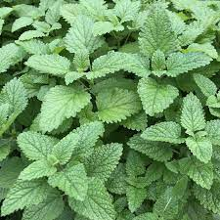
Herb #2: Lemon balm (Melissa officinalis)
Background
Member of the mint family
Originated in the Mediterranean to Western and Central Asia
Tea made from leaves
Used as monastic medicine in the Middle Ages
Notes:
https://www.herbalgram.org/resources/herbalgram/issues/115/table-of-contents/hg115-herbprofile/
https://www.groworganic.com/products/lemon-balm-art-pack

Slide 9
Herb #2: Lemon balm (Melissa officinalis)
Properties
Cooling, slightly drying
Nervine, hypnotic, carminative, antiviral, antibacterial, antianxiety, antidepressant, antioxidant, and diaphoretic
Notes:
https://chestnutherbs.com/the-medicinal-benefits-of-lemon-balm/

Slide 10
Herb #2: Lemon balm (Melissa officinalis)
Cooling properties
Diaphoretic – increases sweating which cools the body
Notes:
https://www.cambridgenaturals.com/blog/hibiscus-relief-for-summer-heat
(flavonoids and proanthocyanidins)
https://www.peacehealth.org/medical-topics/id/hn-4373005#:~:text=Hibiscus%20flowers%20contain%20substantial%20quantities,%2Dreducing%20(antipyretic)%20activities.

Slide 11
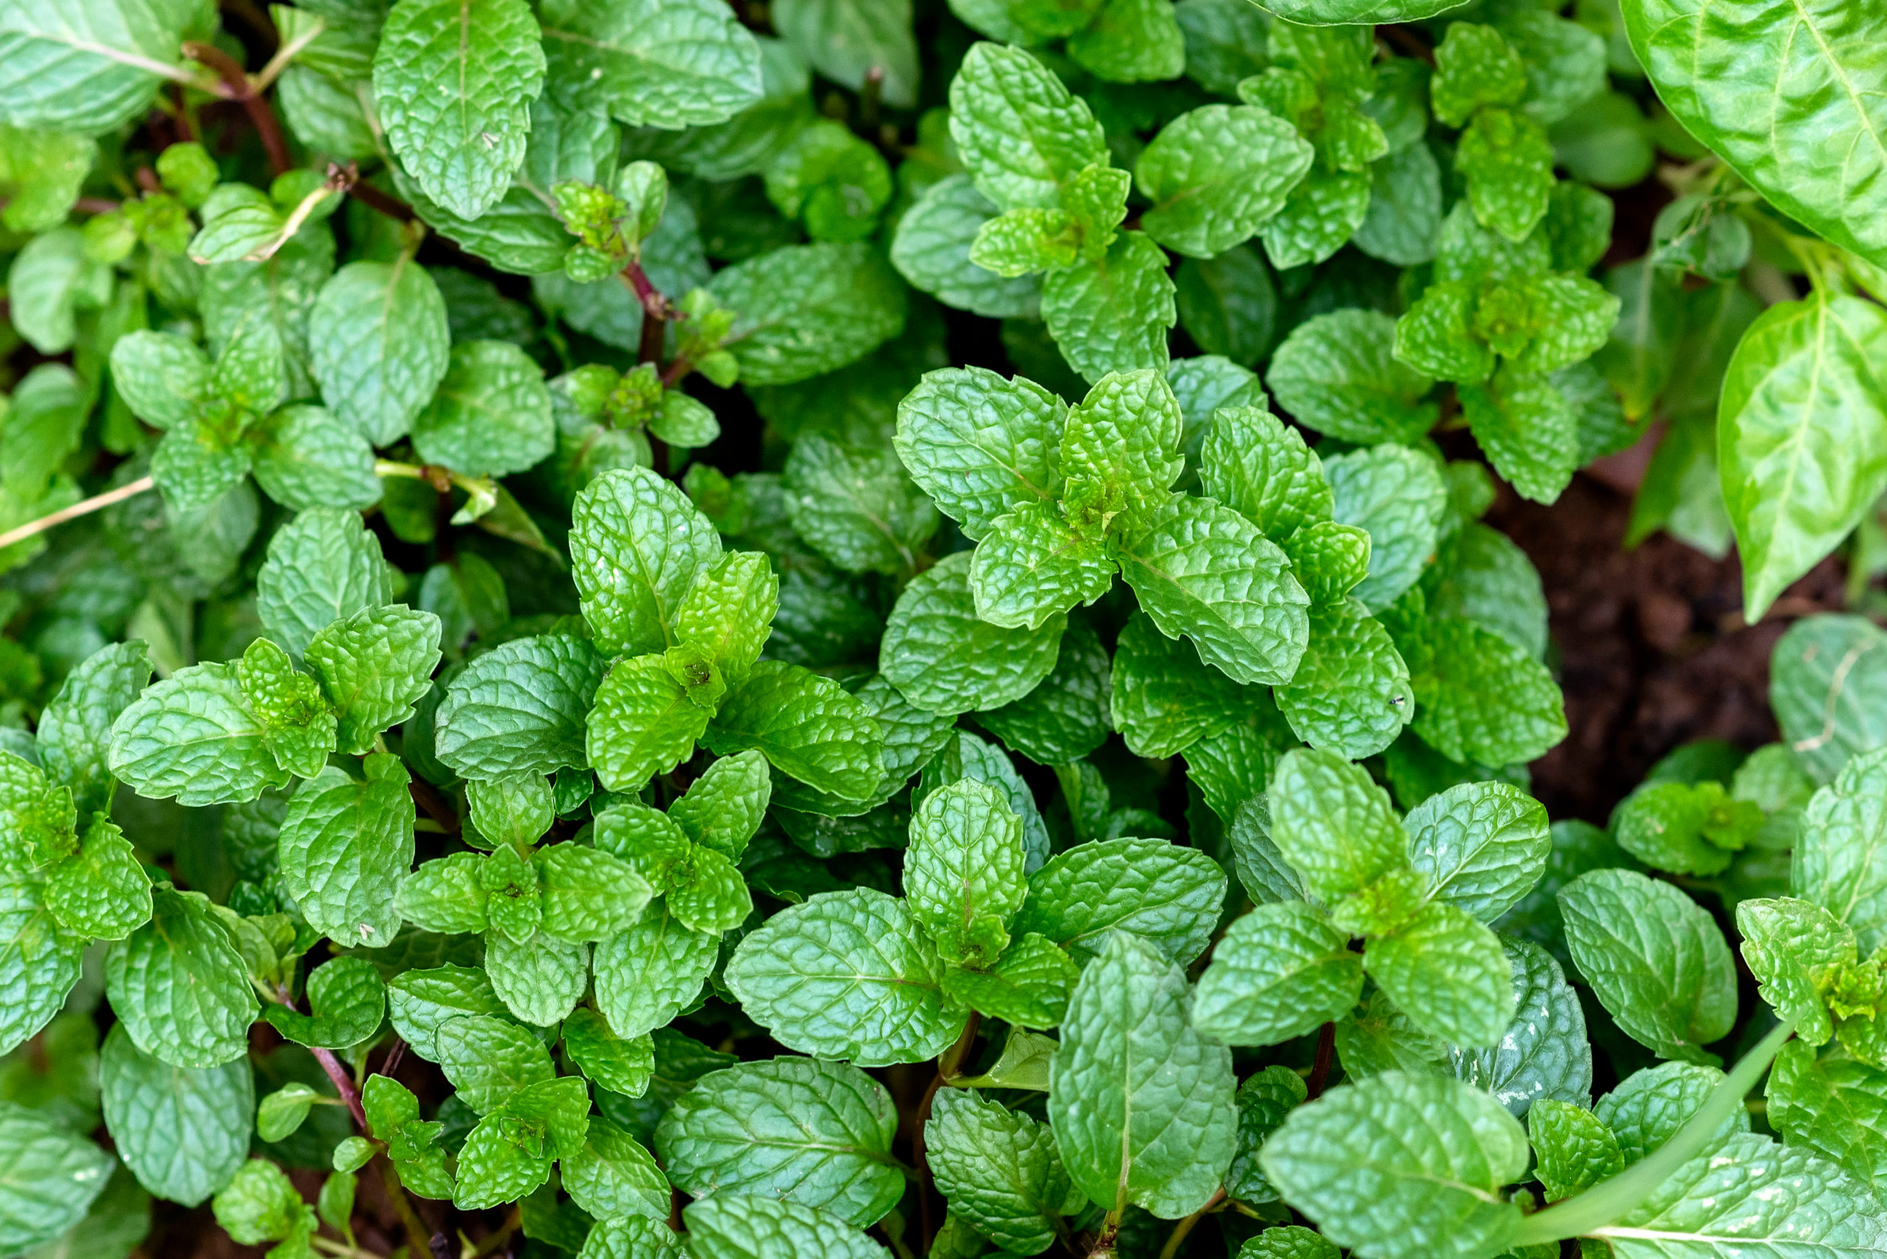
Herb #3: Peppermint (Mentha piperita)
Background
Member of the mint family
Possibly originated in the Mediterranean; grows wild in US and Europe
Tea made from leaves
Long history of ancient use – Roman, Greek, Middle East
Notes:
https://urbantilth.org/wp-content/uploads/2021/10/peppermint-1-1536x1025.jpeg
https://www.herbalgram.org/resources/healthy-ingredients/peppermint/

Slide 12
Herb #3: Peppermint (Mentha piperita)
Properties
Diffusive, drying
Aromatic, carminative, diaphoretic, analgesic, antimicrobial, antispasmodic, anti-inflammatory, nervine, antioxidant.
Notes:
https://www.acornherbschool.com/peppermint
Diffusive herbs move energy out – helps to move heat

Slide 13
Herb #3: Peppermint (Mentha piperita)
Cooling properties
Moves heat out – energetically speaking
Triggers “cold” receptors on the tongue
Notes:
the organic compound menthol (redolent in the leaves of mint) triggers the same protein sensory receptors in the mouth as does cold temperature while, say, eating ice cream. In the case of both mint and cold that protein is TRPM8
https://www.uchealth.org/today/mint-tricks-the-body-into-feeling-cool/#:~:text=Going%20down%20the%20hatch%2C%20the,%E2%80%9Ctrip%20M%208%E2%80%9D).

Slide 14
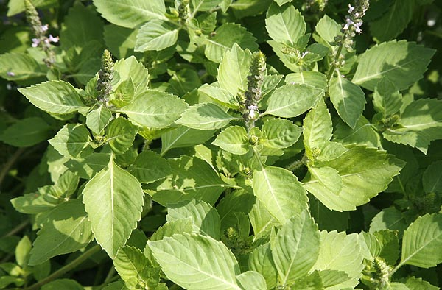
Herb #4: Tulsi/Holy basil (Ocimum sanctum)
Background
Member of the mint family
Native to India and parts of northern and eastern Africa, Hainan Island, and Taiwan
Tea made from leaves
Long history of ancient use – “The Queen of herbs” in Ayurvedic Medicine
Notes:
Or Ocimum tenuiflorum - heterotypic synonym based on different specimens; Tulsi = sanskrit
https://www.floralencounters.com/Seeds/seed_detail.jsp?grow=Basil+Holy&productid=1190
https://www.herbalgram.org/resources/herbalgram/issues/98/table-of-contents/hg98herbpro-holybasil/

Slide 15
Herb # 4: Tulsi/Holy basil (Ocimum sanctum)
Properties
Warming and cooling
Adaptogenic, antibacterial, antipyretic/febrifuge (reduces fever), antiseptic, antispasmodic, carminative (relieves intestinal gas), diaphoretic (promotes sweating), expectorant, nervine, and stimulant.
Notes:
https://www.herbrally.com/monographs/tulsi
https://www.herbalgram.org/resources/herbalgram/issues/98/table-of-contents/hg98herbpro-holybasil/

Slide 16
Herb # 4: Tulsi/Holy basil
Cooling properties
Can induce sweating – cools the body
Notes:
the organic compound menthol (redolent in the leaves of mint) triggers the same protein sensory receptors in the mouth as does cold temperature while, say, eating ice cream. In the case of both mint and cold that protein is TRPM8
https://www.uchealth.org/today/mint-tricks-the-body-into-feeling-cool/#:~:text=Going%20down%20the%20hatch%2C%20the,%E2%80%9Ctrip%20M%208%E2%80%9D).

Slide 17
Herbal Infusion

Slide 18
Brewing Tea (herbal infusion) – applicable to many herbs
Tea (herbal infusion) – Hibiscus - 1 cup
Step 1: Heat one cup of water to boiling
Step 2: Measure 1-2 teaspoons of dried hibiscus and place in an infuser OR take 1 tea bag of hibiscus and place in a cup
Step 3: Pour the boiling water over the tea
Step 4: Cover and steep your tea for 5-7 minutes or longer, if desired
Step 5: Remove the infuser or tea bag
Step 6a: Drink hot – add your favorite sweetener if desired, and enjoy
Step 6b: Drink cold – allow the tea to cool then add to a glass filled with ice; add favorite sweetener if desired
BREW
Notes:
https://chestnutherbs.com/medicinal-benefits-of-hibiscus/
https://www.republicoftea.com/blog/tea-library/how-long-to-steep-hibiscus-tea/tl-027/

Slide 19
Create Your Own Blend

Slide 20
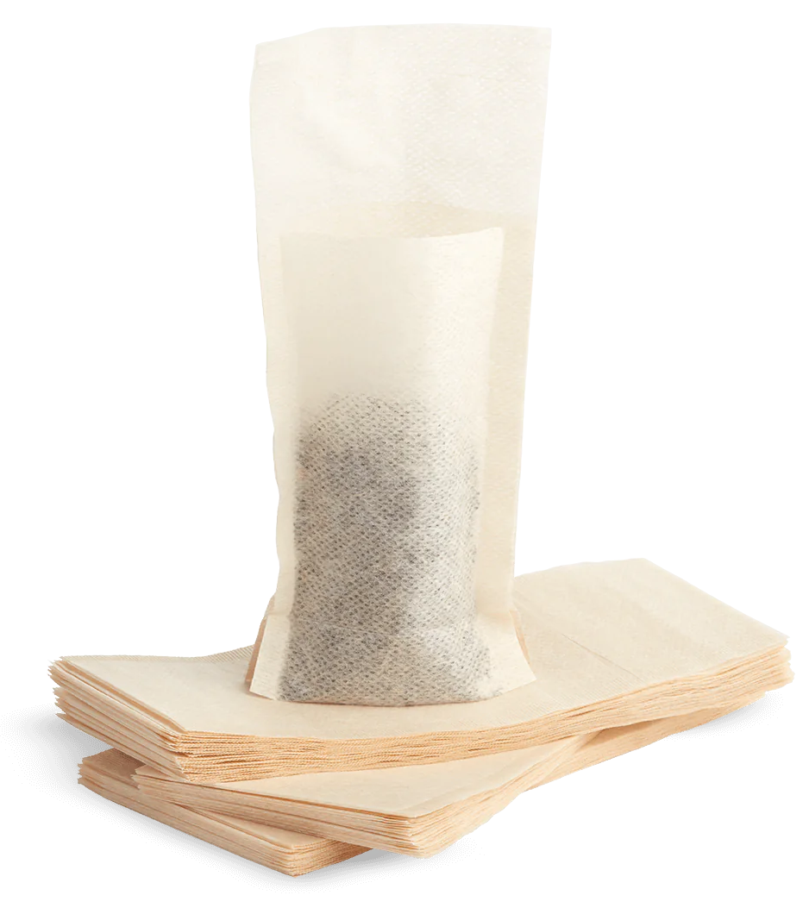
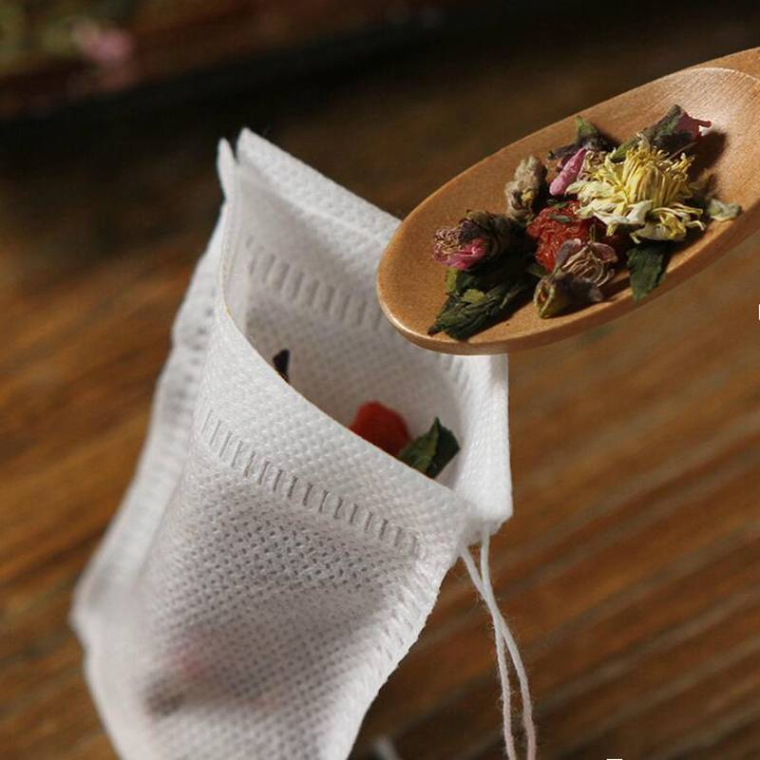
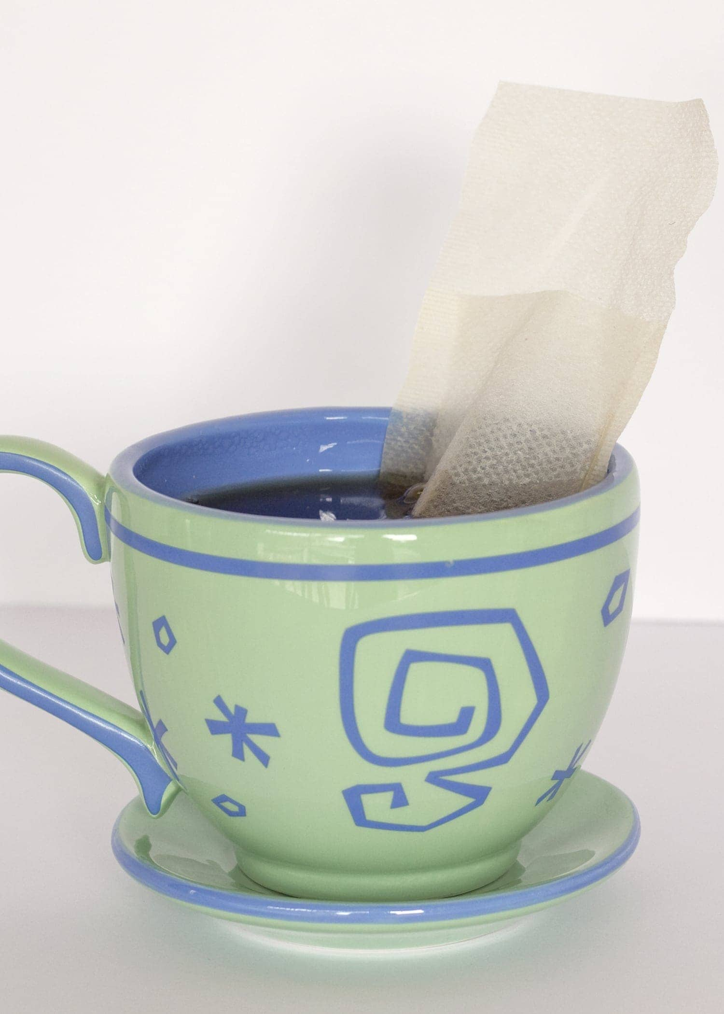
Make your own tea bag to take home
Choose your herbs
Add ½ to 1 tsp of each herb to your tea bag
Mix
Tie tea bag with string, if desired
At home, brew using directions from earlier slide
Notes:
https://www.peets.com/products/t-sac-tea-filters?currency=USD&utm_medium=cpc&utm_source=google&utm_campaign=Google%20Shopping&gclid=CjwKCAjw5_GmBhBIEiwA5QSMxPqdsQaWHfzztVJUHRYCNYtY5wIHXAIGwb9so5bGAmjT0nIaeE-ZWxoCSSYQAvD_BwE
https://www.tradernickstea.com/product/t-sac/

Slide 21
Summary
Today we:
Discussed 4 different herbs
Explored what properties they have
Detailed how they can help cool you down on a hot day
Described how they can be made into tea
Brewed one herbal tea
Created our own herbal tea (infusion) blends

Slide 22
Thank you!

